Slide 1
Robot
Kwantlen Polytechnic University
APSC 1299
Instructor: Michael Coombes
Group Member: Xiaoyou Liang
Umair Rashid
Ridhi Dalla

Slide 2
What is the Project?
Unique strategy to transform working code
Overcome a list of specific obstacles
Two different approaches

Slide 3
First Approach
(Using Timers)
90 degree turns
Gaps and dead end
Acute angled turns

Slide 4

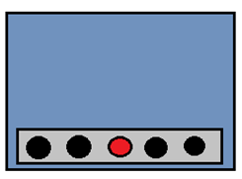

Conditions for 90 degree Turns
1.
2.
3.

Slide 5
Gap and Dead Ends

Slide 6
Conditions for Acute Angle Turns
1
2.
Checks sensors again
1.
2.

Slide 7
New Approach:
We decide to take this new approach since our acute angle wasn’t working.
Our new approach should work for both acute and 90 degree angles.
We decided to try the new approach on 90 degree angles first.

Slide 8
Conditions for 90 degree Turns
1.
2.
3.

Slide 9

90 Degree Turns
1.
3.
2.

Slide 10
How did we change it?
We used do-while loops instead of timers.
Why did we change it?
Acute angles did not work.
Based on same concept as acute angle turns.
Timers are unpredictable due to the voltage change.

Slide 11
Acute Angled Turns
Detection of conditions using slow motion camera.
No timers involved.
Angles are different.

Slide 12
Conditions for Acute Angle Turns
1.
2.

Slide 13


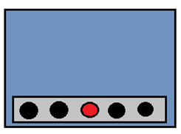
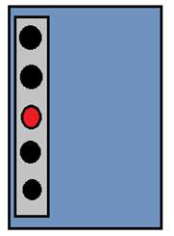

Acute Angle Turns
1.
3.
2.
2.

Slide 14
Acute Angled Turns
Even though some bigger angles might activate the 90 degree function. It will still work.

Slide 15
Acute Angle Turns
1.
3.
2.
2.

Slide 16
Gaps
requires the use of timers only once
efficiency of the code improved
timer runs for 0.48 ms
turns around or follows the path

Slide 17

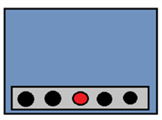
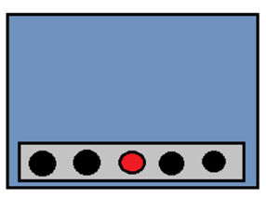

Gaps
A timer runs for 0.48 seconds

Slide 18
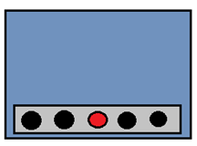

Tight Curves

Slide 19
90 Degrees Crossing
We created a function for the condition in which all five leds light up or detects all black.
If it does detect all black then it uses timers to go straight for 0.12 seconds.

Slide 20

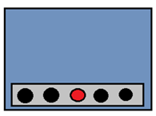
90 degrees crossing
1.
2.
3.

Slide 21
90 Degrees Crossing Error
We got inconsistent results.
Used slow motion camera to understand the problem.
Error was that the robot got stuck in the 90 degree function.
Solution was to break out of the 90 degree function when it detects all black.

Slide 22
90 degrees crossing
1.
2.
3.

Slide 23
Stopping the robot
Used the same function as the 90 degree crossing function.
After the timer has finished the function checks for one last condition before returning.
It checks if the sensors are still all black and if they are then stop the robot.

Slide 24
Crossing at an angle
The condition is similar to our acute angle function.
Used slow motion camera to find a secondary condition that occurs after the initial condition.
Finally used timers
If it does not detect for 0.64sec then break out of the function.

Slide 25



Angled crossing
2.

Slide 26
Merging at an angle
Merging works as long as there is straight path or a 90 degree turn.
It doesn’t work if there is merging at an angle.
Used slow motion camera to find the problem.
After merging the robot gets stuck in 90 degree function, and turns the opposite way.

Slide 27

Angled Merge
1.
2.
3.

Slide 28
ROBOT TRACK CHALLENGE DAY
FIRST TRIAL
4 TOUCHES
MERGES WERENT WORKING PROPERLY.
FOUND THE PROBLEM.

Slide 29
Angled Merge Error
1.
3.

Slide 30
ROBOT TRACK CHALLENGE DAY
SECOND TRIAL
5 TOUCHES
MERGES STILL WERENT WORKING PROPERLY.
FINALLY FOUND THE SOLUTION.

Slide 31
Angled Merge Solution
4.
5.
6.

Slide 32
ROBOT TRACK CHALLENGE DAY
THIRD TRIAL
ZERO TOUCHES – YAY!!!
MERGES WORKED PROPERLY.
OUR SOLUTION WORKED.

Slide 33
Competition – Test Day
First run:
four touches
Second run:
five touches
Final run:
NO TOUCH!!
FINISH IN 40 SECONDS!!!

Slide 34
THANK YOU!
QUESTIONS?

